Slide 1
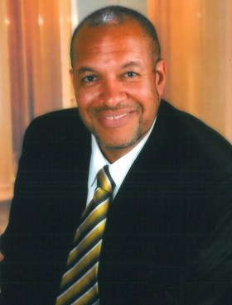
Join Pastor Darryl For
Weekday Inspiration
One Minute Message via Facebook Live between 8am-9am
  www.facebook.com/Darryl.Matthews
Midday Inspiration From The Psalms between noon-1pm
  Periscope smarphone app: search for Rev Darryl Matthews

Slide 2
The First Christmas
Gifts Given
Matthew 2:1-12
Dr Darryl M. Matthews
www.pastordarryl.com
2016 December 25

Slide 3
The First Christmas
Gifts Given
Matthew 2:1-12
1After Jesus was born in Bethlehem in Judea, during the time of King Herod, Magi from the east came to Jerusalem
2 and asked, “Where is the one who has been born king of the Jews? We saw his star when it rose and have come to worship him.”
3 When King Herod heard this he was disturbed, and all Jerusalem with him.

Slide 4
The First Christmas
Gifts Given
Matthew 2:1-12
4 When he had called together all the people’s chief priests and teachers of the law, he asked them where the Messiah was to be born.
5 “In Bethlehem in Judea,” they replied, “for this is what the prophet has written:

Slide 5
The First Christmas
Gifts Given
Matthew 2:1-12
6 “‘But you, Bethlehem, in the land of Judah, are by no means least among the rulers of Judah; for out of you will come a ruler who will shepherd my people Israel.’”
7 Then Herod called the Magi secretly and found out from them the exact time the star had appeared.

Slide 6
The First Christmas
Gifts Given
Matthew 2:1-12
8 He sent them to Bethlehem and said, “Go and search carefully for the child. As soon as you find him, report to me, so that I too may go and worship him.”
9 After they had heard the king, they went on their way, and the star they had seen when it rose went ahead of them until it stopped over the place where the child was.

Slide 7
The First Christmas
Gifts Given
Matthew 2:1-12
10 When they saw the star, they were overjoyed.
11 On coming to the house, they saw the child with his mother Mary, and they bowed down and worshiped him. Then they opened their treasures and presented him with gifts of gold, frankincense and myrrh.

Slide 8
The First Christmas
Gifts Given
Matthew 2:1-12
12 And having been warned in a dream not to go back to Herod, they returned to their country by another route.

Slide 9
The First Christmas
Gifts Given
Matthew 2:1-12
Dr Darryl M. Matthews
www.pastordarryl.com
2016 December 25

Slide 10
The First Christmas
Gifts Given
Matthew 2:1-12
Gold: Jesus’ Royalty

Slide 11
The First Christmas
Gifts Given
Matthew 2:1-12
Gold: Jesus’ Royalty
Frankincense: Jesus’ Divinity

Slide 12
The First Christmas
Gifts Given
Matthew 2:1-12
Gold: Jesus’ Royalty
Frankincense: Jesus’ Divinity
Myrrh: Jesus’ Humanity

Slide 13
The First Christmas
Gifts Given
Matthew 2:1-12
Dr Darryl M. Matthews
www.pastordarryl.com
2016 December 25

